Slide 1

Vel Tech Rangarajan Dr. Sagunthala R&D Institute of Science and Technology
School of Computing
Department of Computer Science and Engineering
10211CS224 / FULL STACK APPLICATION DEVELOPMENT (JAVA)
PROJECT REVIEW : MILESTONE PROJECT – 2
Date: 17-04-2026
Ticket Booking of an Internal Department Event
SDG: SDG No – SDG Title(Example: SDG 4 – Quality Education)
Presented By:
S.Jishnu Parameswararao – VTU26604 – 23UECS0877
Courses Handling Faculty:
Dr. Hafizur Rahman – Assistant professor

Slide 2
INTRODUCTION
1
The Event Ticket Booking System is a web-based application developed using React JS.
It allows users to view event details and book tickets online بسهولة.
The system provides a simple and user-friendly interface for easy booking.
Users can enter their details and select the number of tickets required.
Input validation ensures correct data entry and prevents invalid bookings.
The application displays booking summary with total amount.
It also maintains booking history for future reference
2
3
4
5
6
7
8
9

Slide 3
PROBLEM STATEMENT
Traditional event ticket booking systems are mostly manual, making the process time-consuming and inefficient. There is no proper mechanism to track ticket availability and user bookings, which can lead to issues such as overbooking and incorrect data entry. Users also do not receive instant confirmation after booking, causing inconvenience. Additionally, there is no centralized system to store and manage booking records, making it difficult to access booking history when needed. Therefore, there is a need for an automated, user-friendly ticket booking system that can handle bookings efficiently, reduce errors, and provide a better user experience.
1
2
3
4
5
6
7
8
9

Slide 4
OBJECTIVE(S)
1
To develop a user-friendly web application for booking event tickets online.
To ensure accurate booking through input validation and maintain booking records for future reference.
2
3
4
5
6
7
8
9

Slide 5
PROPOSED SYSTEM
The system is a web-based application developed using React JS.
It allows users to view event details such as name, date, venue, and ticket price.
Users can enter their details and book tickets online.
The system validates user inputs to ensure correct and secure data entry.
It prevents overbooking by checking ticket availability.
After booking, it displays a confirmation summary with total amount.
The system stores booking details using local storage.
Users can view their booking history at any time.
It also provides an option to delete specific booking records.
The system offers a simple, fast, and user-friendly booking experience.
1
2
3
4
5
6
7
8
9

Slide 6
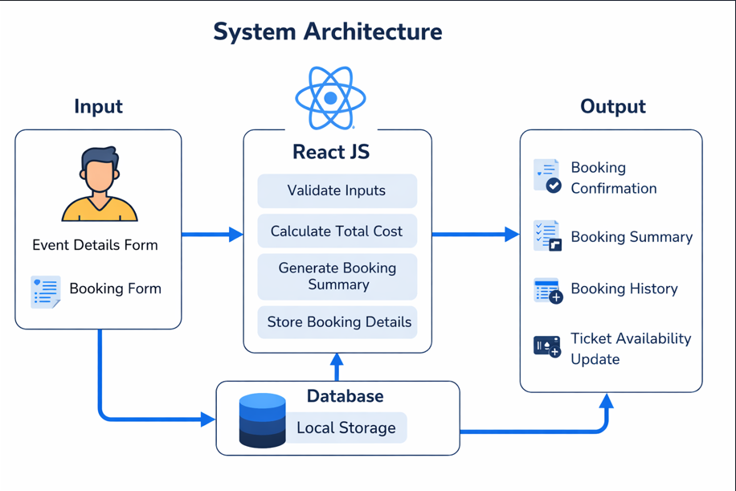

Slide 7
PROPOSED SYSTEM ARCHITECTURE
Input
User views event details
User enters personal details (name, email, department)
User selects number of tickets
Data is entered through form inputs
2. Processing
System validates user inputs
Email format is checked
Ticket availability is verified
Total amount is calculated automatically
Booking request is processed
3. Storage (Database / Local Storage)
Booking details are stored in browser local storage
Stores user details and ticket information
Maintains booking history
Data can be retrieved and updated dynamically
4. Output
Displays booking confirmation instantly
Shows booking summary (user, event, tickets, total amount)
Updates available ticket count
Displays booking history
Allows deletion of specific booking records
1
2
3
4
5
6
7
8
9

Slide 8
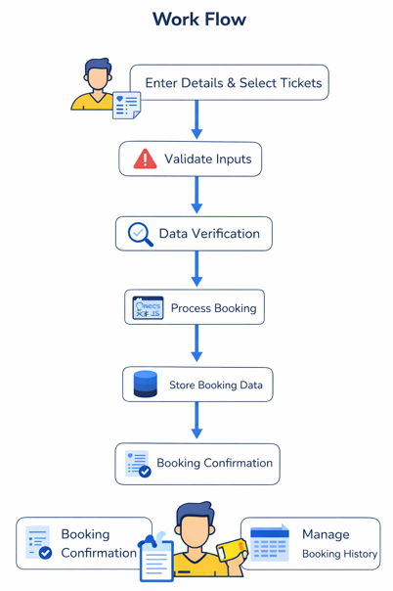
WORKFLOW
1
2
3
4
5
6
7
8
9

Slide 9
TECHNOLOGIES USED
Software Requirements
Operating System: Windows 10/11
Frontend: React JS
Languages: JavaScript (ES6), HTML5, CSS3
Code Editor: Visual Studio Code / Notepad++
Browser: Google Chrome / Microsoft Edge
Package Manager: Node.js & npm
🔹 Hardware Requirements
Processor: Intel i3 or above
RAM: Minimum 4 GB
Storage: At least 10 GB free space
System Type: 64-bit Computer/Laptop
1
2
3
4
5
6
7
8
9

Slide 10
MODULE DESCRIPTION
Module 1: User Interface (Event Details Module)
Handles displaying event information such as event name, department, date, venue, ticket price, and available tickets. It provides a simple and interactive interface for users to view event details before booking tickets.
Module 2: Ticket Booking Module
Implements the core booking functionality by allowing users to enter their details (name, email, department) and select the number of tickets. It validates inputs and prevents overbooking by checking ticket availability.
Module 3: Booking Processing & Storage
Manages the booking process by calculating total cost and storing booking details using browser local storage. It ensures data is saved correctly and can be retrieved later for history display.
Module 4: Summary & History Management
Displays booking confirmation with user details, event name, tickets booked, and total amount. It also maintains booking history, allows users to view past bookings, and delete specific records.
1
2
3
4
5
6
7
8
9

Slide 11
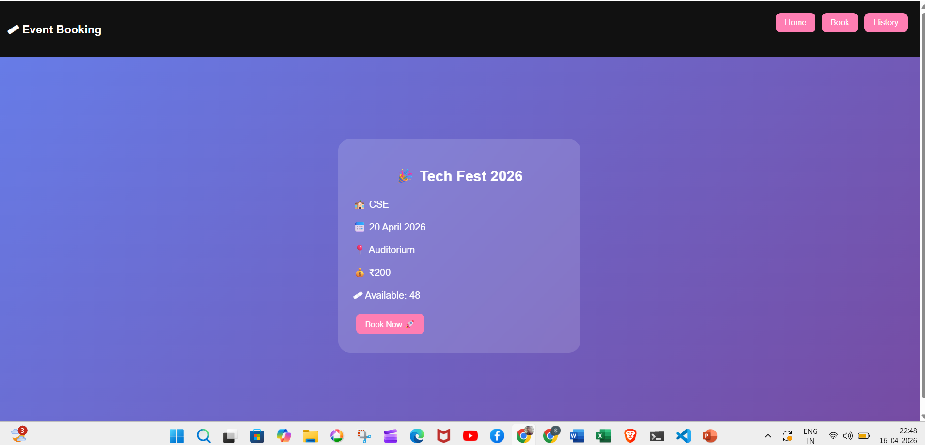
IMPLEMENTATION SCREENSHOTS
1
2
3
4
5
6
7
8
9
This is an event booking page for Tech Fest 2026 showing details like date, venue, and price. Users can easily book tickets using the “Book Now” button.

Slide 12
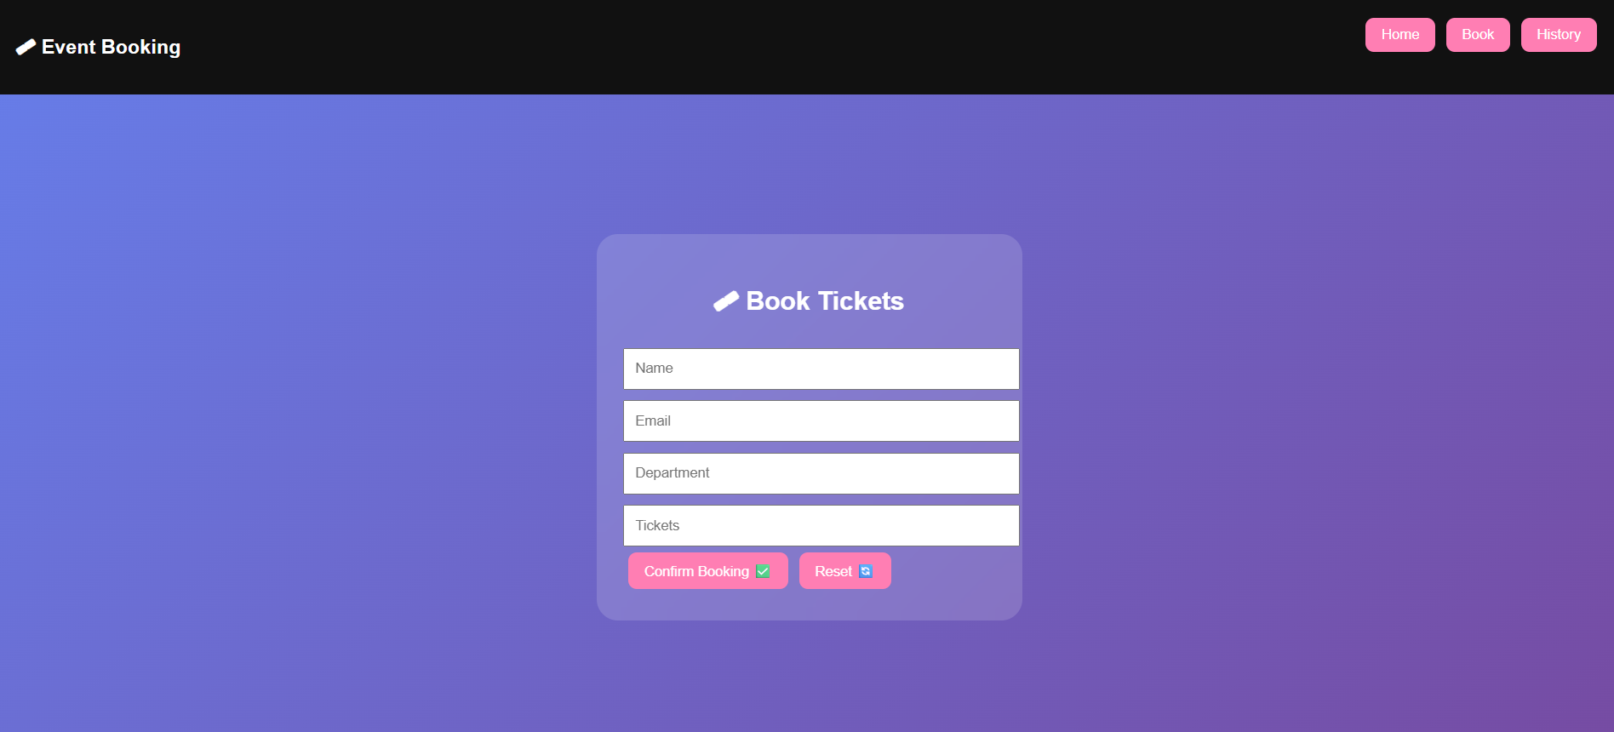
IMPLEMENTATION SCREENSHOTS
1
2
3
4
5
6
7
8(A)
9
This is a ticket booking form where users enter details like name, email, department, and number of tickets. Users can confirm their booking or reset the form easily.

Slide 13
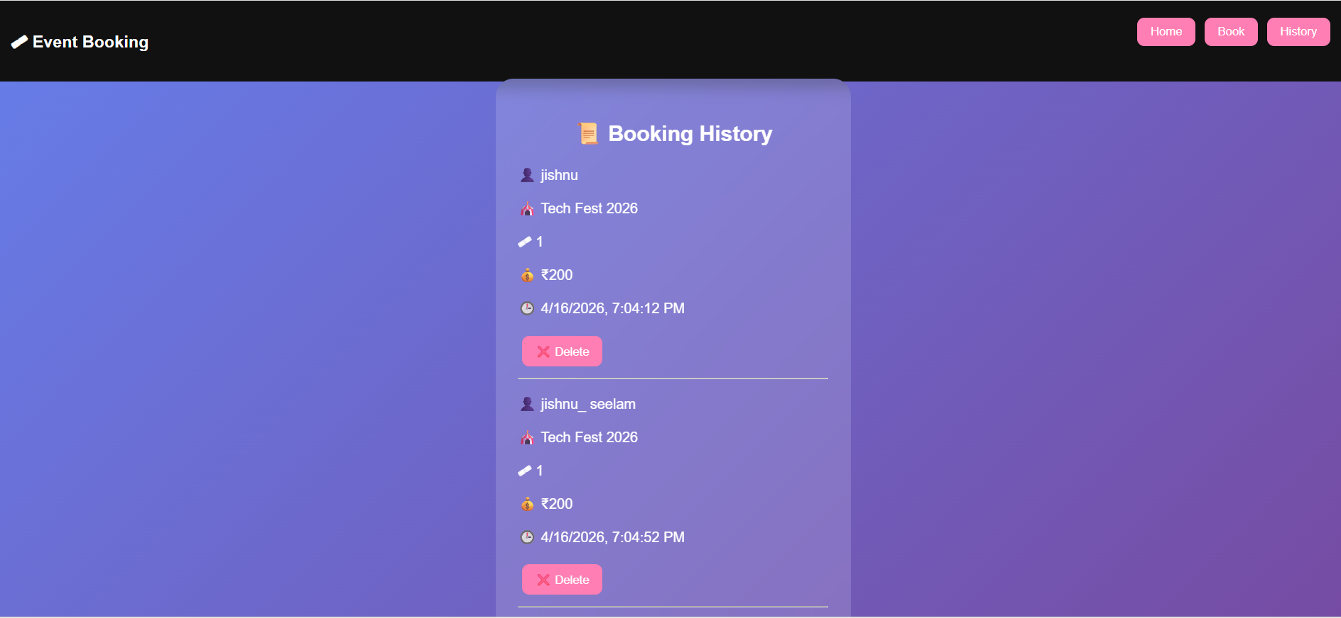
IMPLEMENTATION SCREENSHOTS
1
2
3
4
5
6
7
8(B)
9
This is a booking history page showing all the tickets booked by the user. Users can view details and delete any booking if needed.

Slide 14
ADVANTAGES & LIMITATIONS
1
Advantages
Provides a simple and user-friendly interface for booking tickets.
Reduces manual effort and saves time.
Ensures accurate booking through input validation.
Prevents overbooking by checking ticket availability.
Displays instant booking confirmation and summary.
Maintains booking history for future reference.
Allows deletion of specific booking records.
Limitations
Uses local storage instead of a real database.
Data is limited to a single browser/device.
Requires internet browser to run the application.
Limited scalability and real-time data handling
2
3
4
5
6
7
8
9

Slide 15
Thank you

